Slide 1
Programming in C
By
MS KRITI KAUSIK
kriti29kausik@gmail.com

Slide 2
Additional Features
Unit V

Slide 3
Contents
File Handling
File Pointer File Accessing Functions
fopen(),fclose(),putc(),getc(),fprintf()
C Preprocessor
#define
#include
#undef
Conditional Compilation Directives
C Standard Library and Header Files
Header Files
String Functions
Mathematical Functions
Date and Time Functions

Slide 4
File Concepts
A collection of records (or) group of records.
Record means Collection of fields(or)collection of attributes
NAME | AGE | CLASS | PERCENTAGE
AA | 12 | 1ST | 100
BB | 13 | 2ND | 98
CC | 14 | 3RD | 97
DD | 15 | 4TH | 99
EE | 16 | 5TH | 100

Slide 5
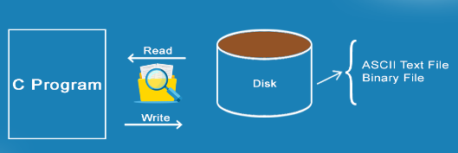
File Handling
File Handling is a mechanism for storing of data in a file using a program.
In C programming language, the programs store results, and other data of the program to a file using file handling in C.
Also, users can extract/fetch data from a file to work with it in the program.

Slide 6
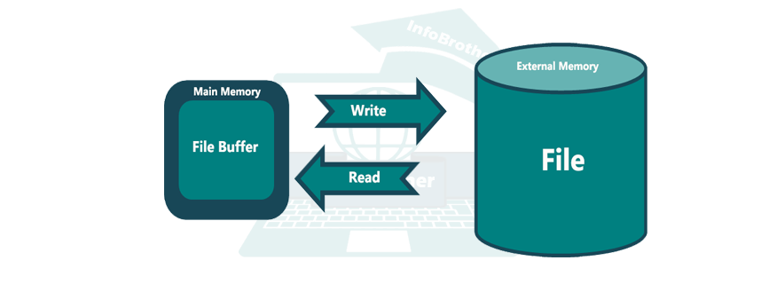
File Concepts
In programming, users may require some specific input data to be generated several numbers of times. Sometimes, it is not enough to only display the data on the console.
The data to be displayed may be very large, and only a limited amount of data can be displayed on the console, and since the memory is volatile, it is impossible to recover the programmatically generated data again and again.
File handling in C enables users to create, update, read, and delete the files stored on the local file system through users C program. The following operations can be performed on a file.
Creation of the new file
Opening an existing file
Reading from the file
Writing to the file
Deleting the file

Slide 7
File Accessing (Operations) - Functions
No. | Function | Description
1 | fopen() | opens new or existing file
2 | fprintf() | write data into the file
3 | fscanf() | reads data from the file
4 | fputc() | writes a character into the file
5 | fgetc() | reads a character from file
6 | fclose() | closes the file
7 | fseek() | sets the file pointer to given position
8 | fputw() | writes an integer to file
9 | fgetw() | reads an integer from file
10 | ftell() | returns current position
11 | rewind() | sets the file pointer to the beginning of the file

Slide 8
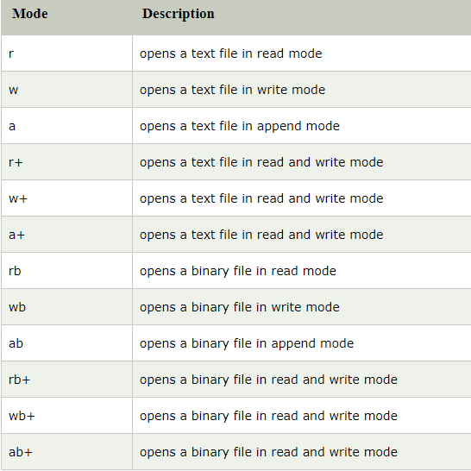
File Operation Modes

Slide 9
File Creation
The fopen() function is used to create a new file or open an existing file in C.
The fopen function is defined in the stdio.h header file.
The syntax for creation of a new file or opening a file
file = fopen(“file_name”, “mode”)
This is a common syntax for both opening and creating a file in C
“file_name” − It is a string that specifies the name of the file that is to be opened or created using the fopen method.
mode: It is a string (usually a single character ) that specifies the mode in which the file is to be opened.

Slide 10
fopen() – File Open
We must open a file before it can be read, write, or update. The fopen() function is used to open a file. The syntax of the fopen() is given below.
FILE *fopen( const char * filename, const char * mode );
The fopen() function accepts two parameters:
The file name (string). If the file is stored at some specific location, then we must mention the path at which the file is stored. For example, a file name can be like "c://some_folder/some_file.ext".
The mode in which the file is to be opened. It is a string.

Slide 11
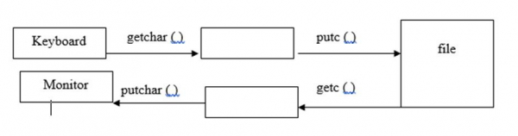
getc() – Function in File
getc( ) function is used to read a character from file
The syntax for getc() function is as follows −
char getc (FILE *fp);
For example,
FILE *fp;
char ch;
ch = getc(fp);

Slide 12
putc() – Function in File
putc( ) function is used for writing a character into a file.
The syntax for putc() function is as follows −
putc (char ch, FILE *fp);
For example,
FILE *fp;
char ch;
putc(ch, fp);
Example
#include<stdio.h>
void main ()
{
char c;
printf("Enter character: ");
c = getc(stdin);
printf("Character entered: ");
putc(c, stdout);
}
Output
Enter character: a
Character entered: a

Slide 13
Example for getc() and putc()
#include<stdio.h>
void main()
{
char ch;
FILE *fp;
fp=fopen("std1.txt","w"); //opening file in write mode
printf("enter the text.press cntrl Z:");
while((ch = getchar())!=EOF)
{
putc(ch,fp); // writing each character into the file
}
fclose(fp);
fp=fopen("std1.txt","r");
printf("text on the file:");
while ((ch=getc(fp))!=EOF) // reading each character from file
{
putchar(ch); // displaying each character on to the screen
}
fclose(fp);
}
Output
enter the text.press cntrl Z:
Hi Welcome to C World
Here I am Presenting Question and answers in C Programming Language
^Z
text on the file:
Hi Welcome to C World
Here I am Presenting Question and answers in C Programming Language

Slide 14
fprintf() function
Writing File : fprintf() function
The fprintf() function is used to write set of characters into file. It sends formatted output to a stream.
Syntax:
int fprintf(FILE *stream, const char *format [, argument, ...])
Example
#include <stdio.h>
main()
{
FILE *fp;
fp = fopen("file.txt", "w");
fprintf(fp, "Hello file by fprintf...\n");
fclose(fp);
}

Slide 15
fscanf() function
Reading File : fscanf() function
The fscanf() function is used to read set of characters from file.
It reads a word from the file and returns EOF at the end of file.
Syntax:
int fscanf(FILE *stream, const char *format [, argument, ...])
Example
#include <stdio.h>
void main()
{
FILE *fp;
char buff[255];
fp = fopen("file.txt", "r");
while(fscanf(fp, "%s", buff)!=EOF)
{
printf("%s ", buff );
}
fclose(fp);
}
Output: Hello file by fprintf...

Slide 16
Example program for File Read
#include<stdio.h>
#include<conio.h>
void main()
{
FILE *ptr;
int c;
clrscr();
ptr=fopen(“total.c”,”r”);
c=getc(ptr);
while(c!=EOF)
{
putchar(c);
c=getc(ptr);
}
fclose(ptr);
getch();
}

Slide 17
Example program for File Write
#include<stdio.h>
#include<conio.h>
void main()
{
FILE *ptr;
clrscr();
ptr=fopen(“sai.txt”,”w”);
fprintf(ptr,”\n %s”,”HELLO HOW ARE YOU!”);
fprintf(ptr,”\n%d”,15000);
fprintf(ptr,”\n%f”,12.9090);
fclose(ptr);
getch();
}

Slide 18
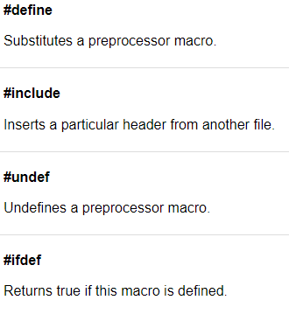
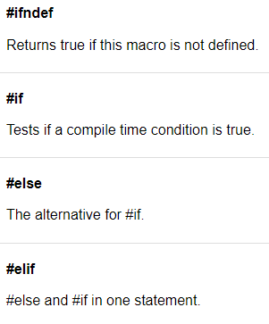
C Preprocessor
C Preprocessor is just a text substitution tool and it instructs the compiler to do required pre-processing before the actual compilation.
It preprocesses instructions before it sends to the compiler
All preprocessor commands begin with a hash symbol (#).

Slide 19
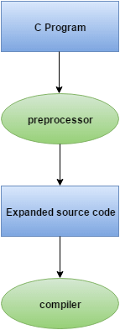
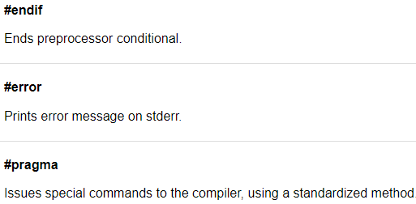
C Preprocessor

Slide 20
C Preprocessor
In programming terminology, a preprocessor is nothing but a System Software that performs the processing of a high-level language before compilation by translating the source code written in a high-level language to object code written in the machine-level language, that is easily understood by the compiler

Slide 21
#inlcude
The #include preprocessor directive is used to paste code of given file into current file.
It is used include system-defined and user-defined header files. If included file is not found, compiler renders error.
By the use of #include directive, user provides information to the preprocessor where to look for the header files.
There are two variants to use #include directive.
#include <filename>
#include "filename“
The #include <filename> tells the compiler to look for the directory where system header files are held.
The #include "filename" tells the compiler to look in the current directory from where program is running.

Slide 22
#inlcude
Example
#include<stdio.h>
int main()
{
printf("Hello C");
return 0;
}
Output
Hello C

Slide 23
#define
The #define preprocessor directive is used to define constant or micro substitution.
It can use any basic data type.
Syntax
#define token value
Example
#include <stdio.h>
#define PI 3.14
void main()
{
printf("%f", PI);
}
Output
3.140000
#include <stdio.h>
#define MIN(a,b) ((a)<(b)?(a):(b))
void main()
{
printf("Minimum between 10 and 20 is: %d\n", MIN(10,20));
}
Output: Minimum between 10 and 20 is: 10

Slide 24
#undef
The #undef preprocessor directive is used to undefine the constant or macro defined by #define.
Syntax:
#undef token
Simple example to define and undefine a constant.
Example
#include <stdio.h>
#define PI 3.14
#undef PI
void main()
{
printf("%f",PI);
}
Output
Compile Time Error: 'PI' undeclared

Slide 25
#undef Example
#include <stdio.h>
#define number 15
int square=number*number;
#undef number
void main()
{
printf("%d",square);
}
Output
225

Slide 26
Conditional Directives
The conditional directives are:
#ifdef - If this macro is defined
#ifndef - If this macro is not defined
#if - Test if a compile time condition is true
#else - The alternative for #if
#elif - #else an #if in one statement
#endif - End preprocessor conditional

Slide 27
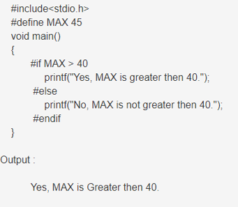
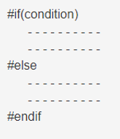
#if directive
The #if preprocessor directive takes condition in parenthesis, if condition is true, then the statements given between #if and #else will get execute.
If condition is false, then statements given between #else and #endif will get execute
Syntax

Slide 28
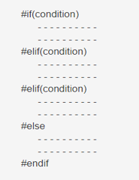
#elif directive
The #elif preprocessor directive is similar to if-else ladder statement. It is used for checking multiple conditions, if the first condition will not satisfy, compiler will jump to #else block and check other condition is true or not and so on.
Syntax

Slide 29
#elif directive
Example
#include <stdio.h>
#define checker 5
void main()
{
#if checker <= 3
printf("This is the if directive block.\n");
#elif checker > 3
printf("This is the elif directive block.\n");
#endif
}
Output
This is the elif directive block

Slide 30
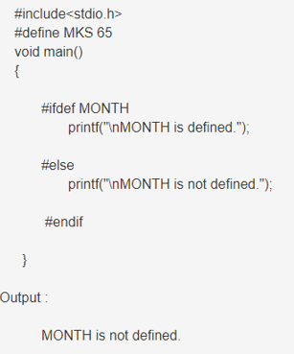
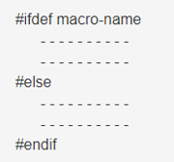
#ifdef directive
The #ifdef preprocessor directive is used to check whether the macro-name is previously defined or not, if defined then the statements given between #ifdef and #else will get execute
Example
Syntax

Slide 31
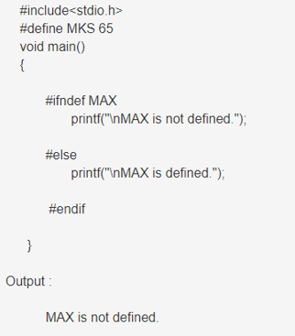
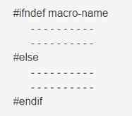
#ifndef directive
The #ifndef preprocessor directive is used to check whether the macro-name is previously defined or not, if not defined then the statements given between #ifndef and #else will get execute.
Example
Syntax

Slide 32
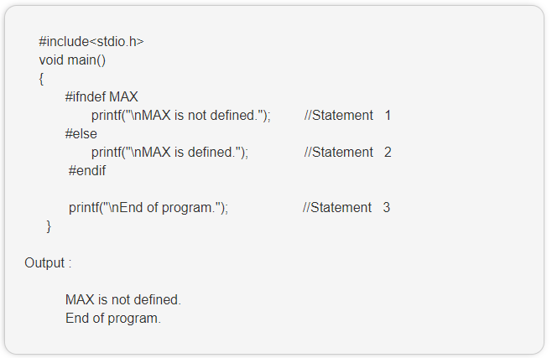
#error directive
The #error preprocessor directive is used to force the compile to stop compiling the source code. In other words we can manually force the compiler to stop compiling and give fatal error.
Example without #error

Slide 33
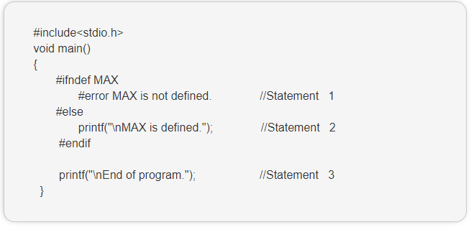
#error directive
#error is a preprocessor directive in C which is used to raise an error during compilation and terminate the process. Usually, the error message is associated with preprocessor conditional statements like #if, #ifdef and others
Example with #error

Slide 34
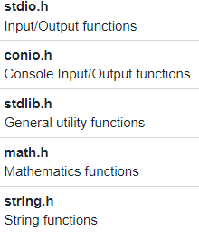
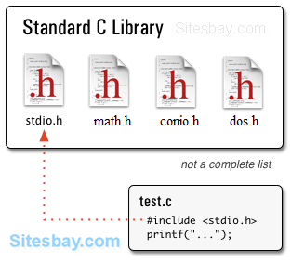
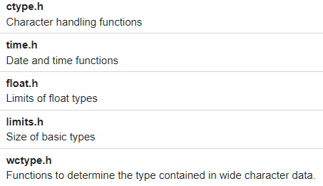
Standard Library Header Files in C

Slide 35
String Functions
No. | Function | Description
1) | strlen(string_name) | returns the length of string name.
2) | strcpy(destination, source) | copies the contents of source string to destination string.
3) | strcat(first_string, second_string) | concats or joins first string with second string. The result of the string is stored in first string.
4) | strcmp(first_string, second_string) | compares the first string with second string. If both strings are same, it returns 0.
5) | strrev(string) | returns reverse string.
6) | strlwr(string) | returns string characters in lowercase.
7) | strupr(string) | returns string characters in uppercase.

Slide 36
Mathematical Functions
No. | Function | Description
1) | ceil(number) | rounds up the given number. It returns the integer value which is greater than or equal to given number.
2) | floor(number) | rounds down the given number. It returns the integer value which is less than or equal to given number.
3) | sqrt(number) | returns the square root of given number.
4) | pow(base, exponent) | returns the power of given number.
5) | abs(number) | returns the absolute value of given number.

Slide 37
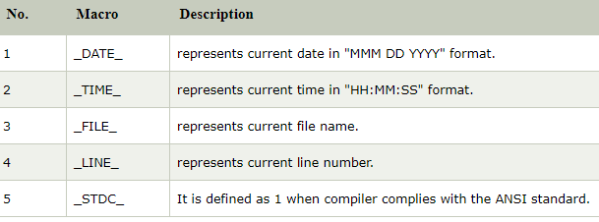
Date and Time Functions
Date and Time predefined functions are

Slide 38
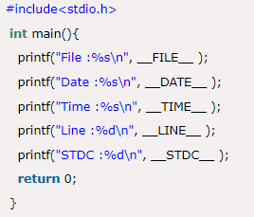
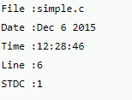
Date and Time Functions
Example

Slide 39

Date and Time Functions
Example
#include <dos.h>
#include <stdio.h>
void main()
{
struct date dt;
getdate(&dt);
printf("System's current date\n");
printf("%d/%d/%d", dt.da_day, dt.da_mon, dt.da_year);
}

Slide 40
Error Handling in C
C language does not provide any direct support for error handling. However a few methods and variables defined in error.h header file can be used to point out error using the return statement in a function.
In C language, a function returns -1 or NULL value in case of any error and a global variable errno is set with the error code. So the return value can be used to check error while programming.

Slide 41
Error No (Code)
Whenever a function call is made in C language, a variable named errno is associated with it.
It is a global variable, which can be used to identify which type of error was encountered while function execution, based on its value. Below we have the list of Error numbers and what does they mean.
errno value | Error
1 | Operation not permitted
2 | No such file or directory
3 | No such process
4 | Interrupted system call
5 | I/O error
6 | No such device or address
7 | Argument list too long
8 | Exec format error
9 | Bad file number
10 | No child processes
11 | Try again
12 | Out of memory
13 | Permission denied

Slide 42
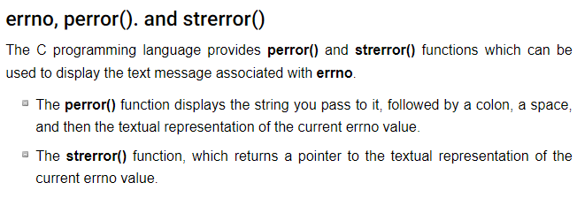
Error Functions

Slide 43
Error Functions
#include <stdio.h>
#include <errno.h>
#include <string.h>
extern int errno ;
Void main ()
{
FILE * pf;
int errnum;
pf = fopen ("unexist.txt", "rb");
if (pf == NULL) {
errnum = errno;
fprintf(stderr, "Value of errno: %d\n", errno);
perror("Error printed by perror");
fprintf(stderr, "Error opening file: %s\n", strerror( errnum ));
} else {
fclose (pf);
}
}
Output
Value of errno: 2
Error printed by perror: No such file or directory
Error opening file: No such file or directory

Slide 44
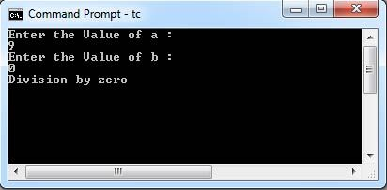
Divide by Zero
It is a common problem that at the time of dividing any number, programmers do not check if a divisor is zero and finally it creates a runtime error.
#include<stdio.h>
void main()
{
int a,b;
float z;
printf("Enter the Value of a :\n");
scanf("%d",&a);
printf("Enter the Value of b :\n");
scanf("%d",&b);
if (b == 0)
printf("Division by zero\n");
else
z = a / b;
printf ("%f", z);
getch();
}

Slide 45
Credits
https://www.javatpoint.com/file-handling-in-c
https://www.tutorialspoint.com/cprogramming/c_preprocessors.htm
https://www.javatpoint.com/c-preprocessor-include
https://www.javatpoint.com/c-preprocessor-undef
https://www.geeksforgeeks.org/getdate-and-setdate-function-in-c-with-examples/
https://www.javatpoint.com/c-string-functions
https://www.javatpoint.com/c-math

Slide 46
Roadmap for Unit V
File Handling
Preprocessor Directives
String, Math and Date Time Functions
1
3
5
2
4
6
File Pointers and Operations
Standard Library and Header Files
Summary

Slide 47

Roadmap to Programming in C
Unit I
Computer Based Problem Solvingand Overview of C
Unit III
Functions and Recursions
Unit V
File Handling, Preprocessor, Standard Library and Header Files
1
3
5
2
4
6
Unit – II
Branching, Looping, Arrays, Strings
Unit IV
Dynamic Data Structures, Pointers, Union
Revision

Slide 48
Thanks!
Any questions?
You can find me at:
kriti29kausik@gmail.com

